Slide 1
Notes:
Figure 10 (b) Monthly averaged and accumulated organic carbon output fluxes from PRE to NSCS via open boundaries; (c) Monthly averaged and accumulated organic carbon net loss in PRE

Slide 2
Notes:
Figure 10 (d) River discharge (m³ s⁻¹) , wind frequency of South-West monsoon and North-East monsoon; in (a)-(d), negative value denotes fluxes output from PRE to adjacent systems and positive value denotes fluxes inputted into PRE.

Slide 3
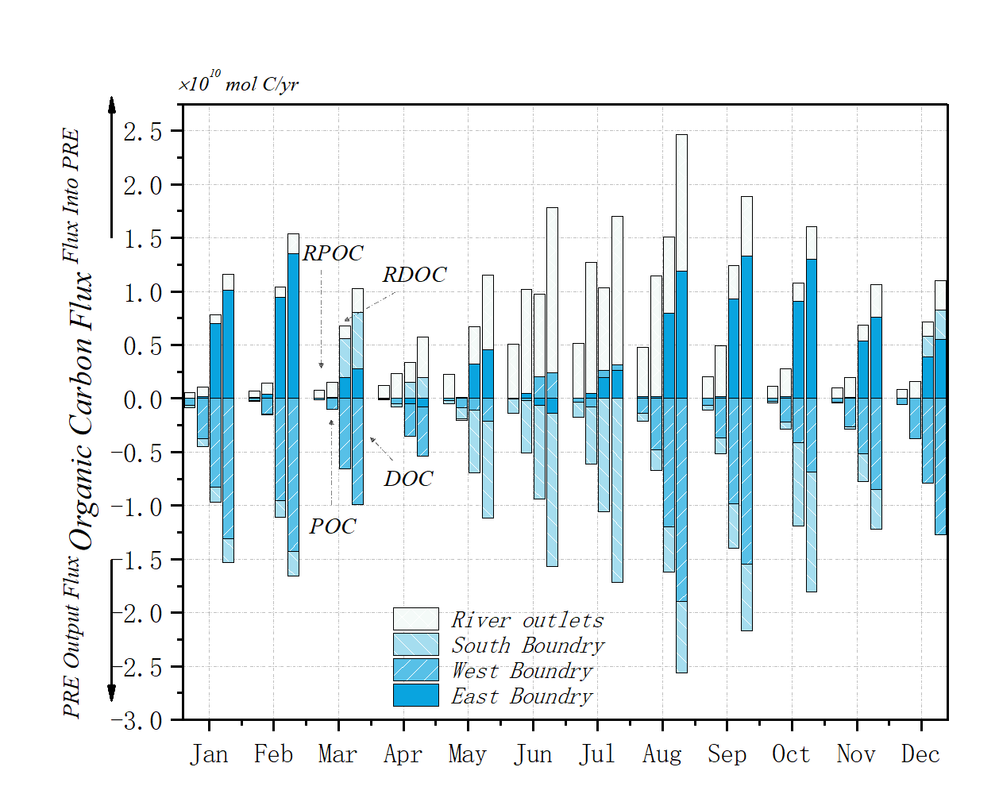
(a)
(b)
(c)

Slide 4
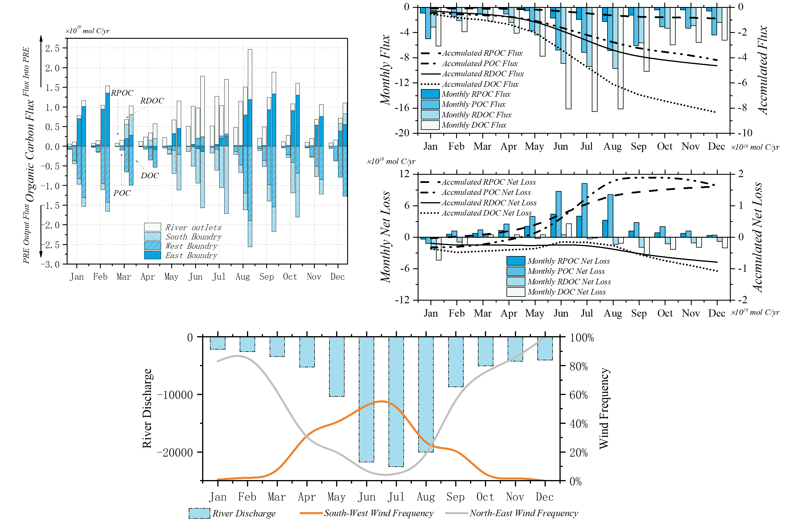
(a)
(b)
(c)
(d)
Notes:
Figure 10 (a) Monthly averaged organic carbon exchange fluxes between PRE and Pearl river/NSCS via four boundaries; (b) Monthly averaged and accumulated organic carbon output fluxes from PRE to NSCS via open boundaries; (c) Monthly averaged and accumulated organic carbon net loss in PRE; (d) River discharge (m³ s⁻¹) , wind frequency of South-West monsoon and North-East monsoon; in (a)-(d), negative value denotes fluxes output from PRE to adjacent systems and positive value denotes fluxes inputted into PRE.

